Slide 1



CRAFTING
SUCCESS
How we navigated change and delivered an effective report
By: Joshua Zavala & Rosie Ortiz

Slide 2






KEYS TO OUR SUCCESS
01
Reach Out for Support
02
Follow the Rubric
03
Use the Template
04
Utilize the CMT
05
The Numbers... What do They Mean?
06
A Spash of Creativity

Slide 3



REACH OUT FOR SUPPORT
Iterate, Refine, and Improve Through Feedback
Key to Successful Report
Don’t Be Afraid to Ask for Help
Membership Department Was the Top Resource
Regional Team Also a Great Resource

Slide 4
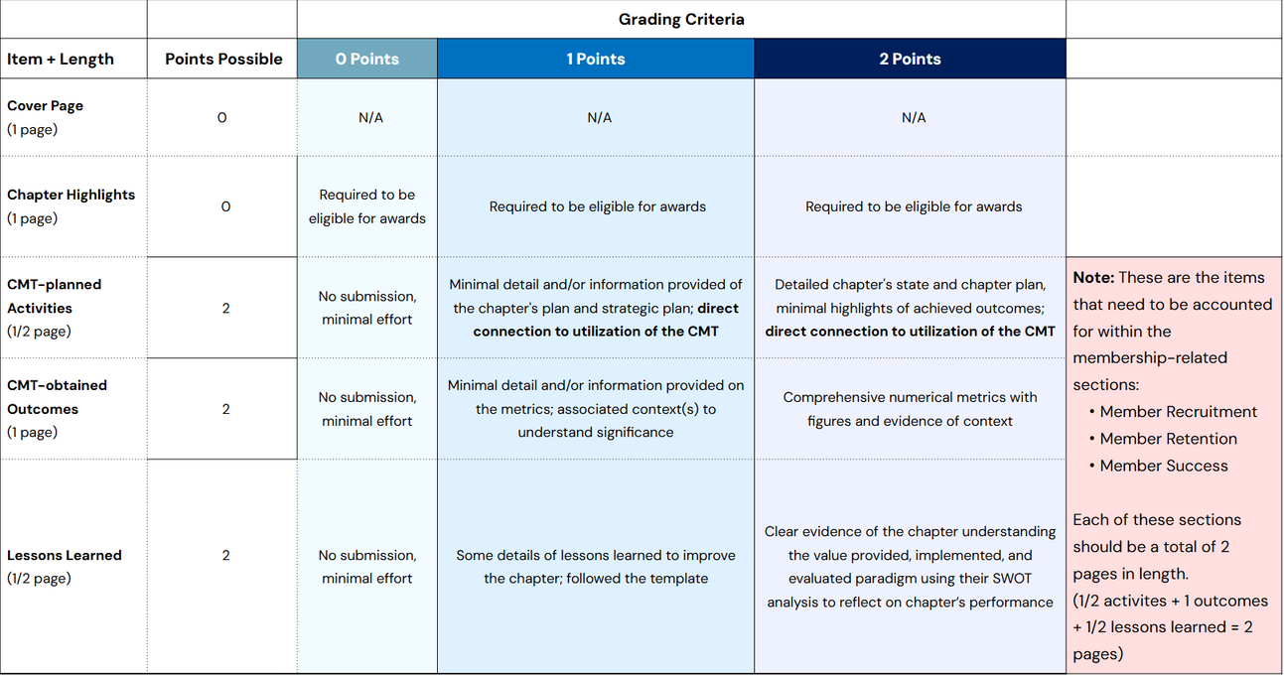
FOLLOW THE RUBRIC
Red Note is Very Important in How the Report Should be Structured
Strive to Hit 2 Points Maximum for all Sections
Focus on CMT, Stats and Detail

Slide 5
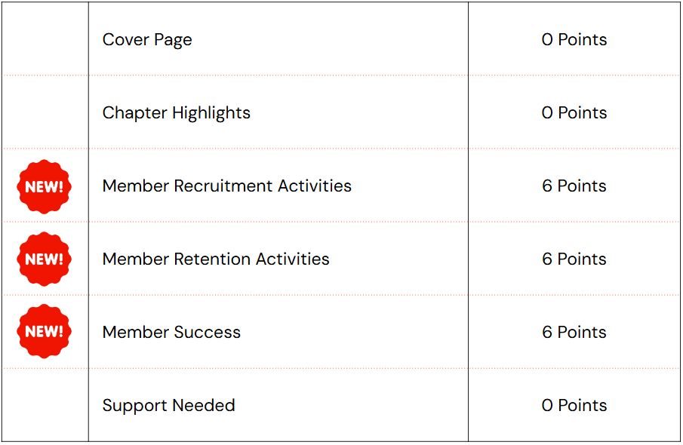
USE THE TEMPLATE
We Used the Template as a Base
Created Our Own Version of the Template
Utilize Contents of Report Diagram & Rubric to create Our Own Version
Asked for Feedback on Our Version

Slide 6
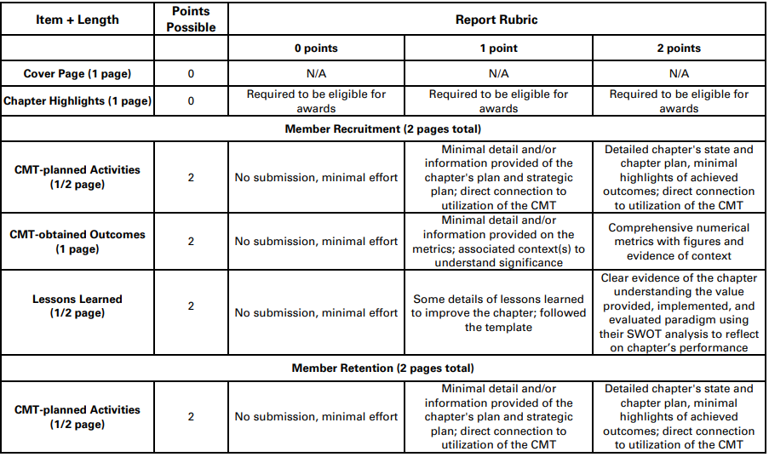
WHEN COMMUNICATION AND INGENUITY COME TOGETHER
Asking questions and testing ideas led to change in the rubric

Slide 7
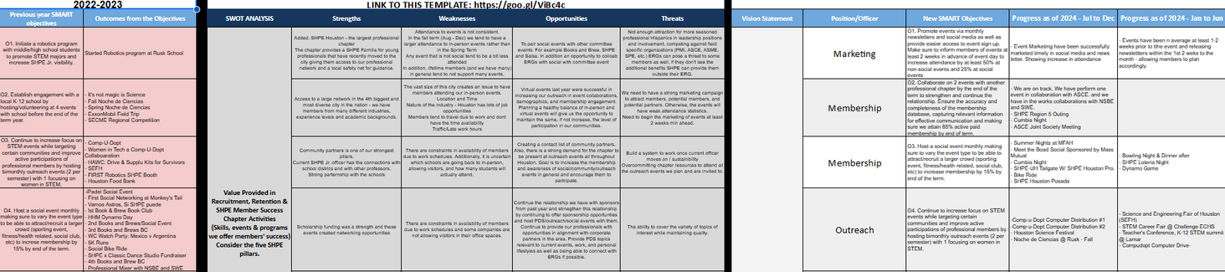
UTILIZE THE CMT
Use CMT to Capture Event Information in Chapter Schedule Tab
Chapter Schedule Information Helps with Content
Use SWOT Analysis to Also Lay Out SMART Goals
Add Event Attendance Numbers
Bring it All Together to Write a Great Report!

Slide 8
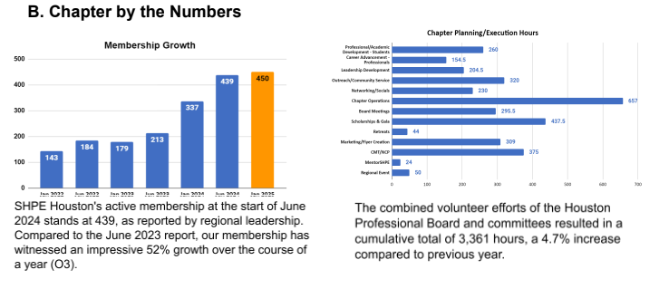
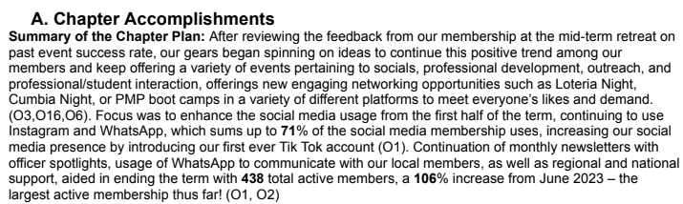
THE NUMBERS
Bring in the Numbers from CMT
Track Volunteer Hours as Often as You Can
Use Metrics from Social Media (Especially LinkedIn)
Use Metrics from Website
Think About All the Different Ways You Can Get Numbers
Compile These Numbers and Make Graphs for Visual Representation

Slide 9

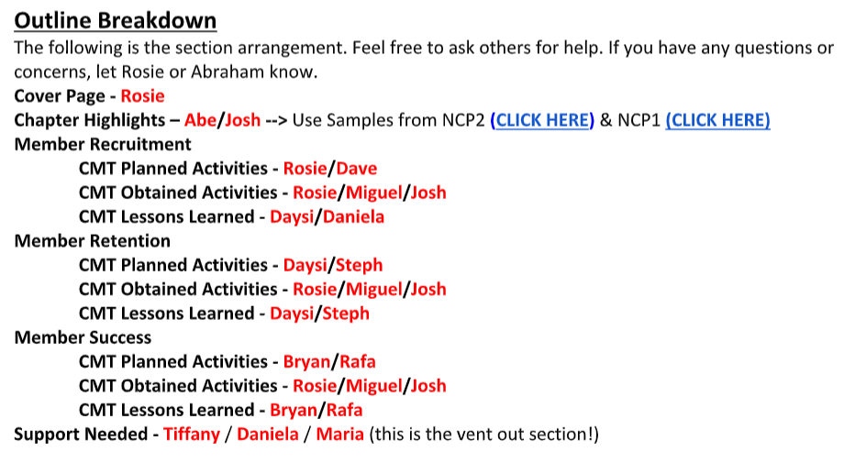
CREATIVITY
Our Creativity Led Us to Think About How This Report Should be Structured
Look at Other Example Reports for Inspiration
An Outside Perspective is Always Helpful
Add Your Own Creative Touches
Have Fun

Slide 10
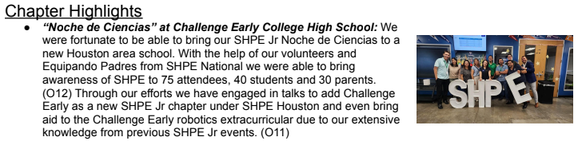
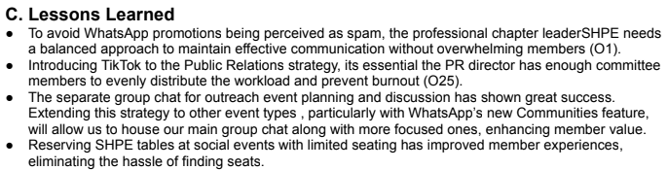
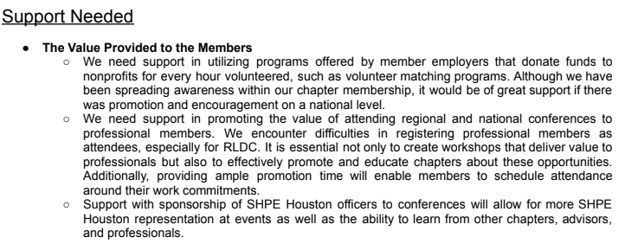
EXAMPLES

Slide 11
QUESTIONS?

Slide 12
THANK YOU

